Slide 1
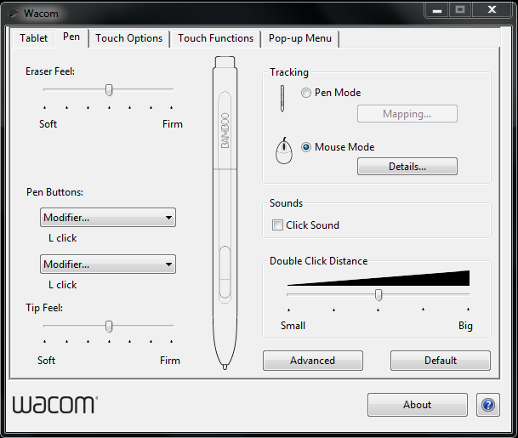
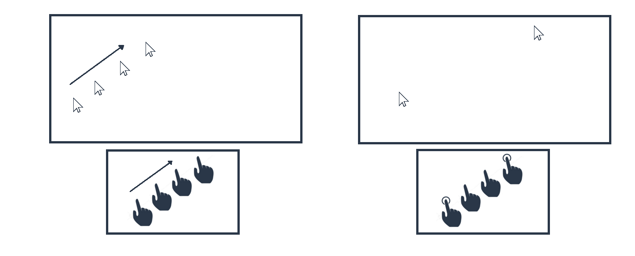
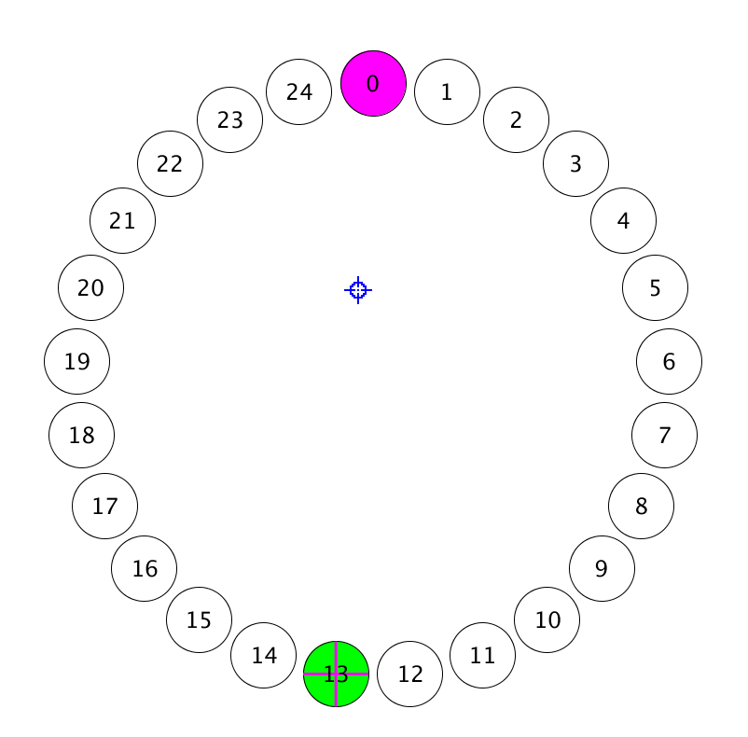
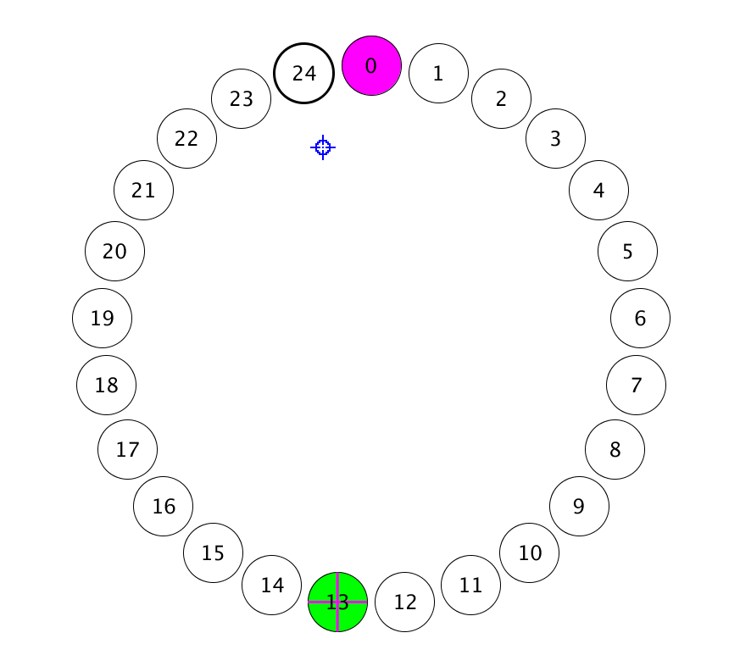
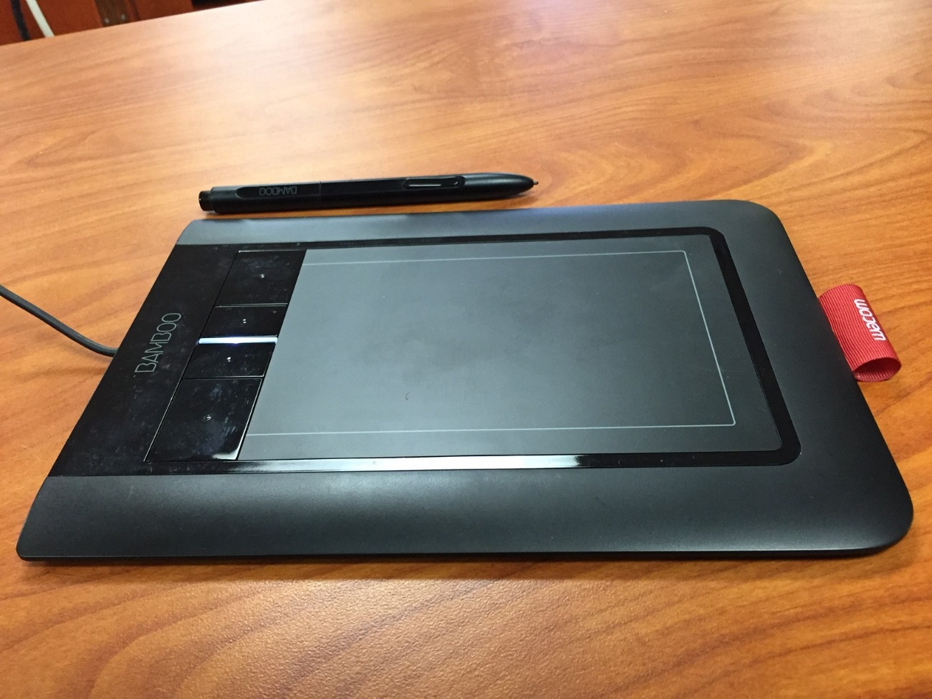
Comparison of Absolute vs. Relative Position Tracking With and Without a “Bubble Assist” Technique: A Fitts’s Law Analysis
Luke Dillman & James McManus with Scott Bateman
University of New Brunswick
CS 6905 – Interactive Human-Centred Systems – Course Project
Background
As technology advances, the number of input methods increase
Such methods include
Relative Control
Absolute Control
Currently, absolute control mapping is not commonly used
Can an absolute control touchpad perform as well as a relative control touchpad?
Early Obstacles
Clicking while adjusting
Relative input sensitivity seemed unnatural
Solutions
Click on release and click on key press were designed/implemented to allow for adjustments in both the absolute and relative positioning modes.
A pilot study was done to determine a preferred sensitivity setting for relative positioning
System
A standard Fitts’s Law Throughput test system was created
Useable with and without Bubble Assist
Relative Control
Absolute Control
Problem (Opportunity)
The optimal input method for non touch screen devices is currently unknown
Absolute Control may have the potential to be faster than relative positioning
Relative Control:
Pro: Easy to understand and control
Con: Cursor must be slid across the screen which can be slow
Absolute Control:
Pro: Can jump across the screen which can be fast
Con: it is likely inaccurate because it is difficult for people to guess the touchpad location
If people are inaccurate with absolute control, can the bubble cursor technique “Bubble Assist” improve their accuracy?
Normal
Bubble
Normal Targets: target selected when cursor is over target circle.
Bubble Targets: closest target to cursor is selected.
Practical Application
Laptop touchpad Design
Tablet Presentation techniques
Assistive technique for visually impaired users
Problem Solution
Create a system to compare Absolute vs Relative Positioning with and with out Bubble Assist
Results
Results coming in the near future, but give it a try and tell us what you think!

